Slide 1

GRAPH THEORY AND ITS APPLICATIONS
Dr. Arti Arya
Department of Computer Science & Engineering

Slide 2
GRAPH THEORY AND ITS APPLICATIONS
MAX FLOW
Dr. Arti Arya
Department of Computer Science & Engineering

Slide 3

Graph Theory and its Applications MAX FLOW
Imagine a material coursing through a system from a source, where the material is produced, to a sink, where it is consumed. The source produces the material at some steady rate, and the sink consumes the material at the same rate. The “flow” of the material at any point in the system is intuitively the rate at which the material moves.
Flow networks can model many problems, including liquids flowing through pipes, parts through assembly lines, current through electrical networks, and information through communication networks.

Slide 4
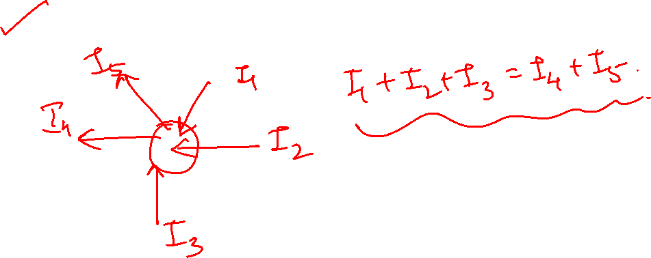
Kirchoff’s Law

Slide 5
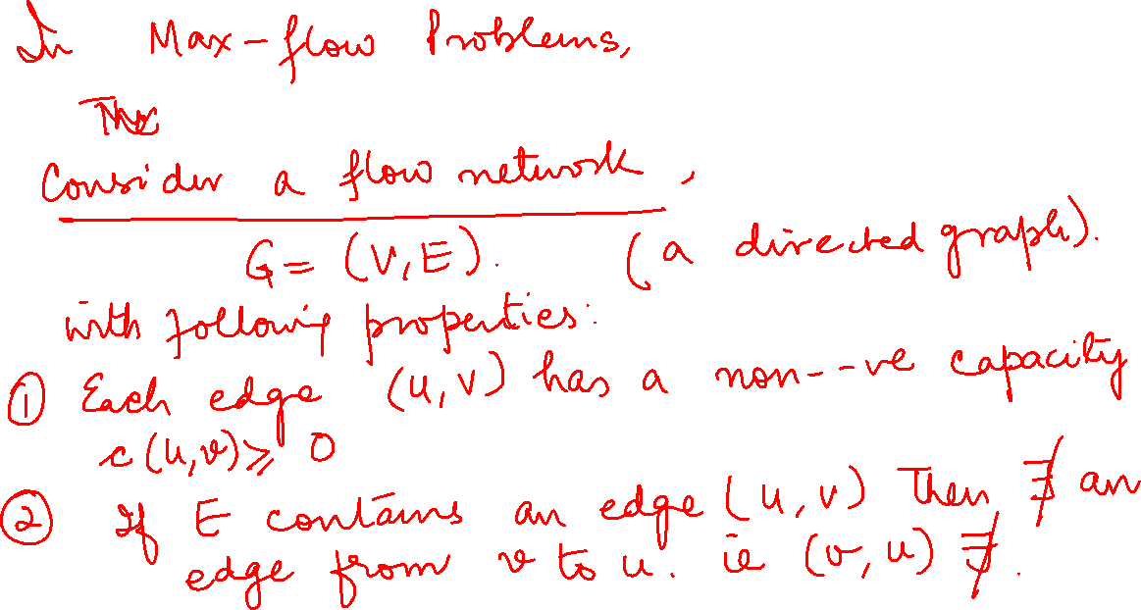

Slide 6
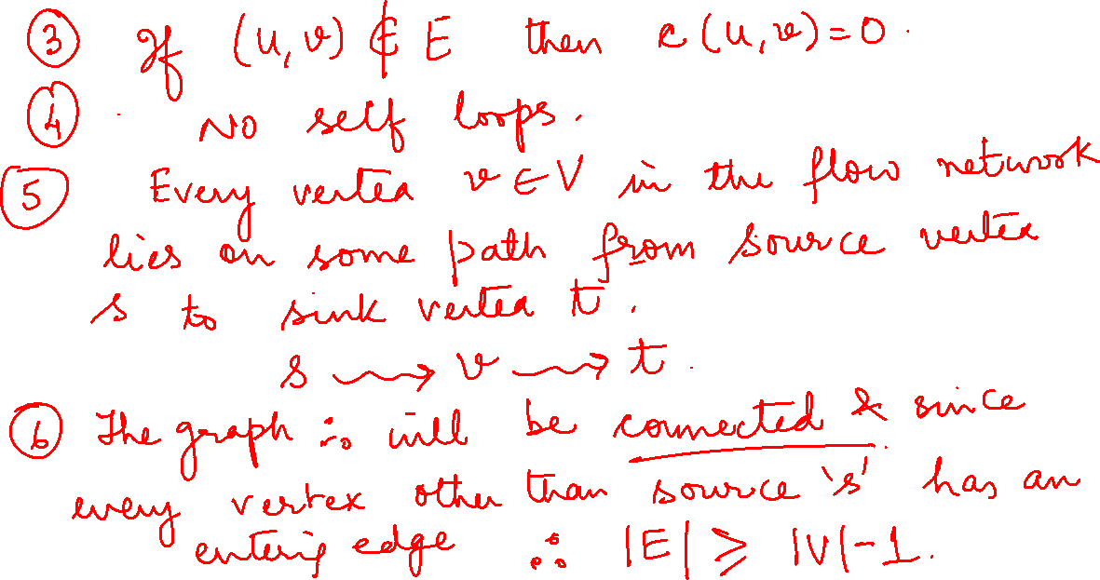

Slide 7
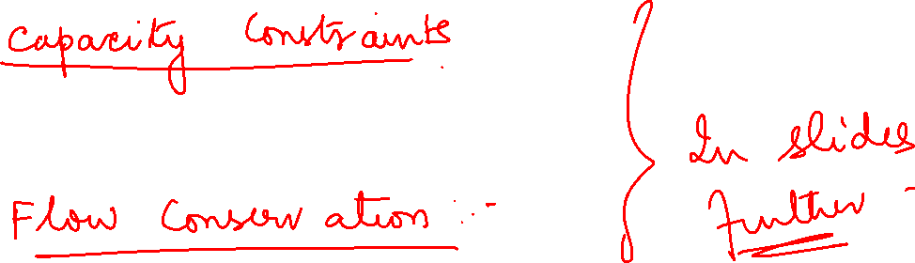

Slide 8
Graph Theory and its Applications MAX FLOW
We can think of each directed edge in a flow network as a conduit for the material. Each conduit has a stated capacity, given as a maximum rate at which the material can flow through the conduit, such as 200 gallons of liquid per hour through a pipe or 20 amperes of electrical current through a wire.
Vertices are conduit junctions, and other than the source and sink, material flows through the vertices without collecting in them. In other words, the rate at which material enters a vertex must equal the rate at which it leaves the vertex. We call this property “flow conservation,” and it is equivalent to Kirchhoff’s current law when the material is electrical current.

Slide 9
Graph Theory and its Applications MAX FLOW
We can think of each directed edge in a flow network as a conduit for the material. Each conduit has a stated capacity, given as a maximum rate at which the material can flow through the conduit, such as 200 gallons of liquid per hour through a pipe or 20 amperes of electrical current through a wire.
Vertices are conduit junctions, and other than the source and sink, material flows through the vertices without collecting in them. In other words, the rate at which material enters a vertex must equal the rate at which it leaves the vertex. We call this property “flow conservation,” and it is equivalent to Kirchhoff’s current law when the material is electrical current.
In the maximum-flow problem, we wish to compute the greatest rate at which we can ship material from the source to the sink without violating any capacity constraints.

Slide 10
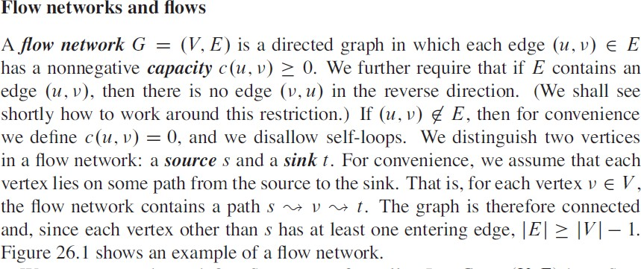
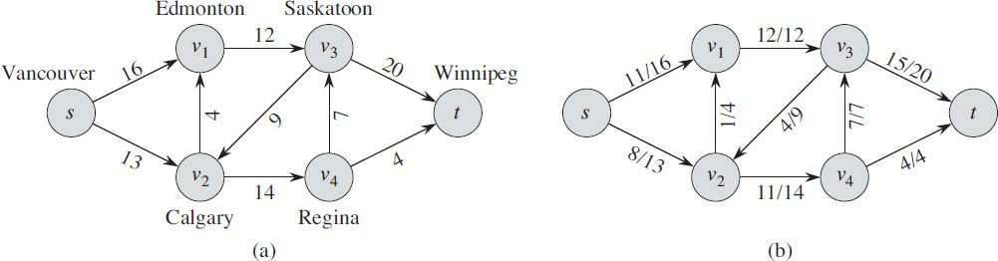
Graph Theory and its Applications MAX FLOW

Slide 11
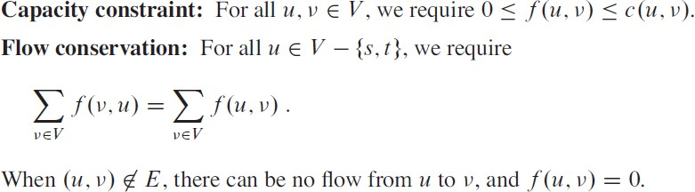
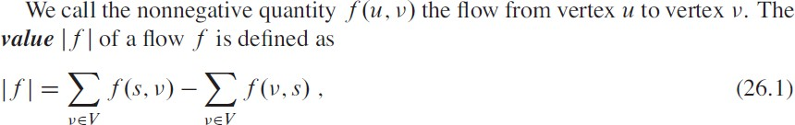
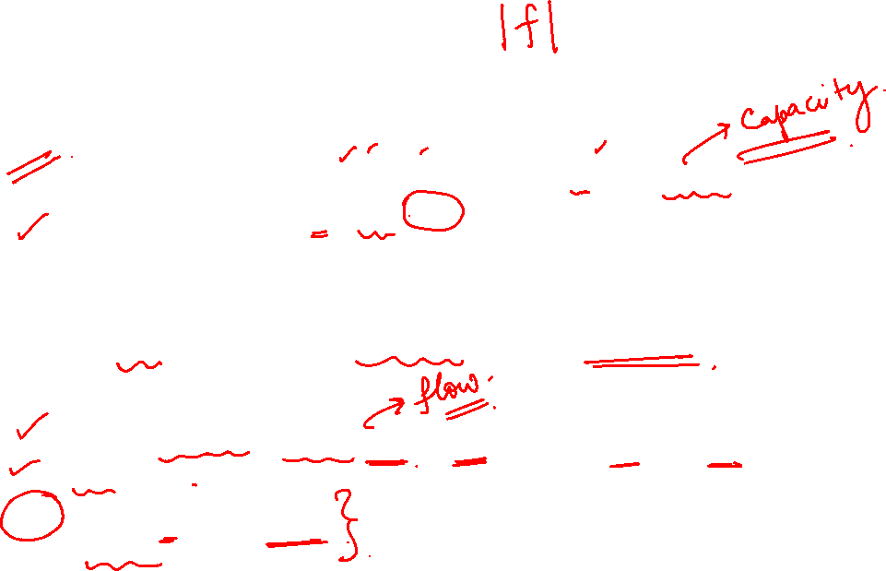
Graph Theory and its Applications MAX FLOW

Slide 12
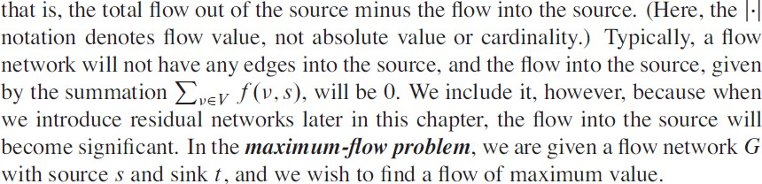
Graph Theory and its Applications MAX FLOW

Slide 13
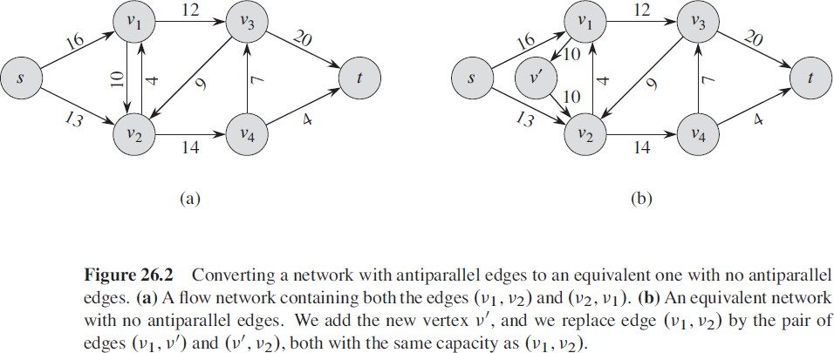
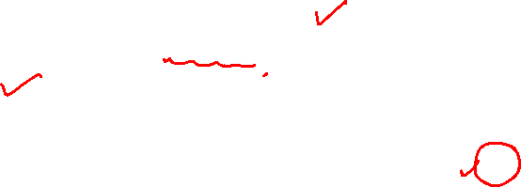
Graph Theory and its Applications MAX FLOW

Slide 14
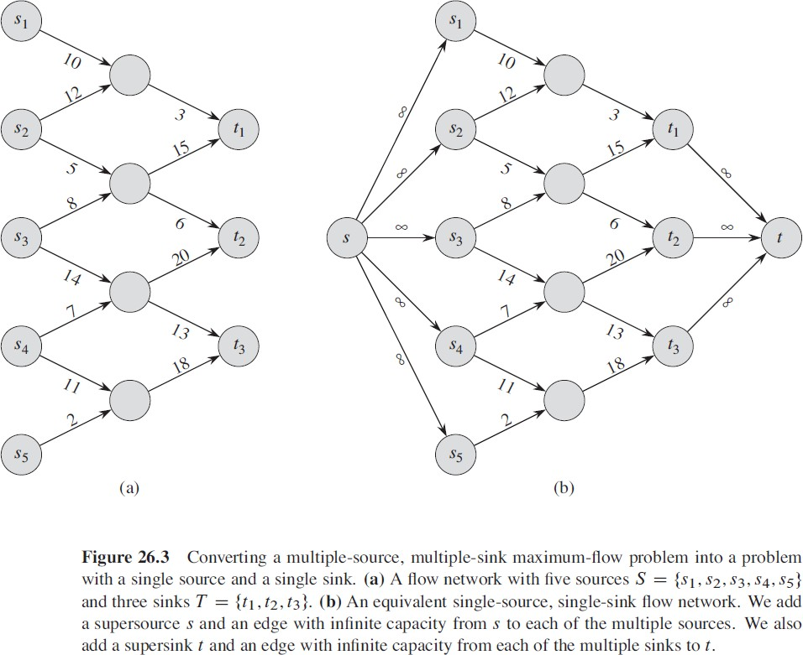

Graph Theory and its Applications MAX FLOW

Slide 15
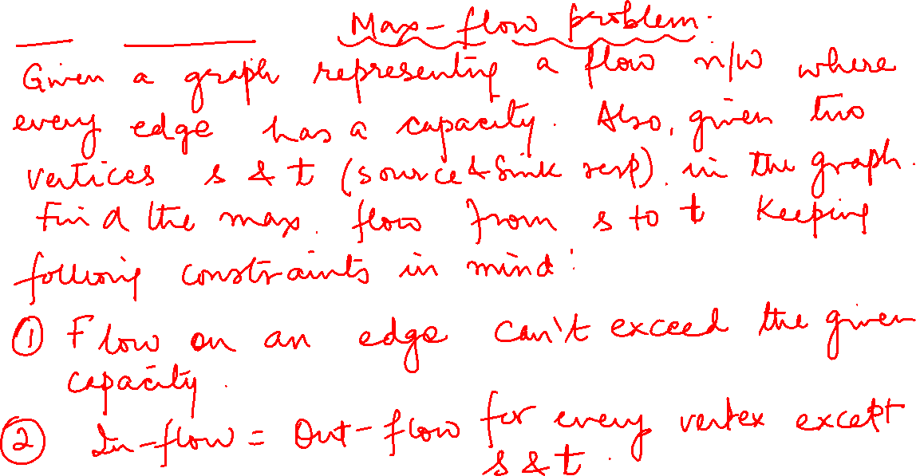
Ford Fulkerson Algorithm

Slide 16
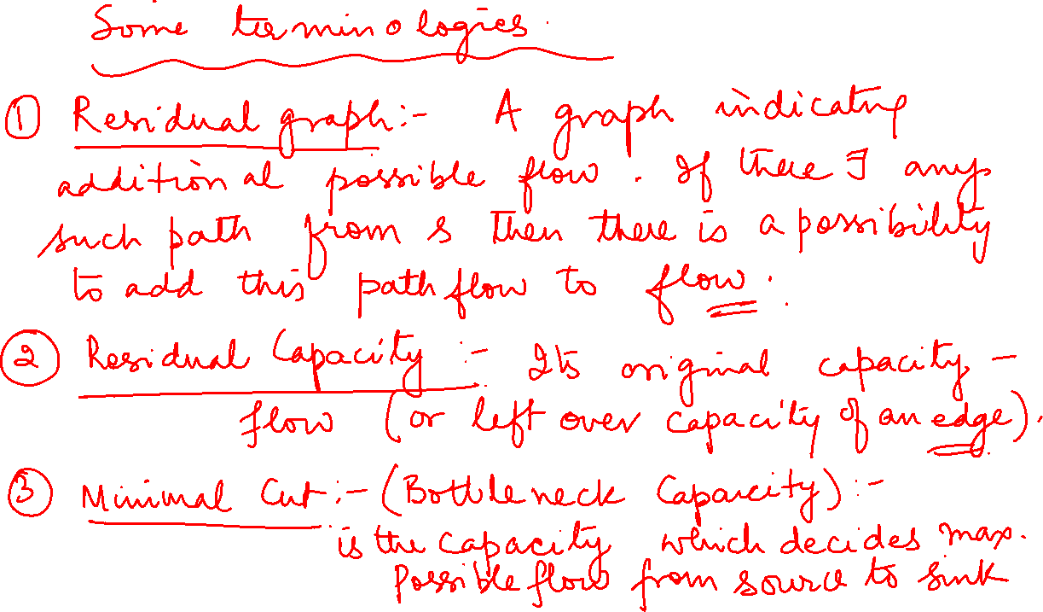

Slide 17
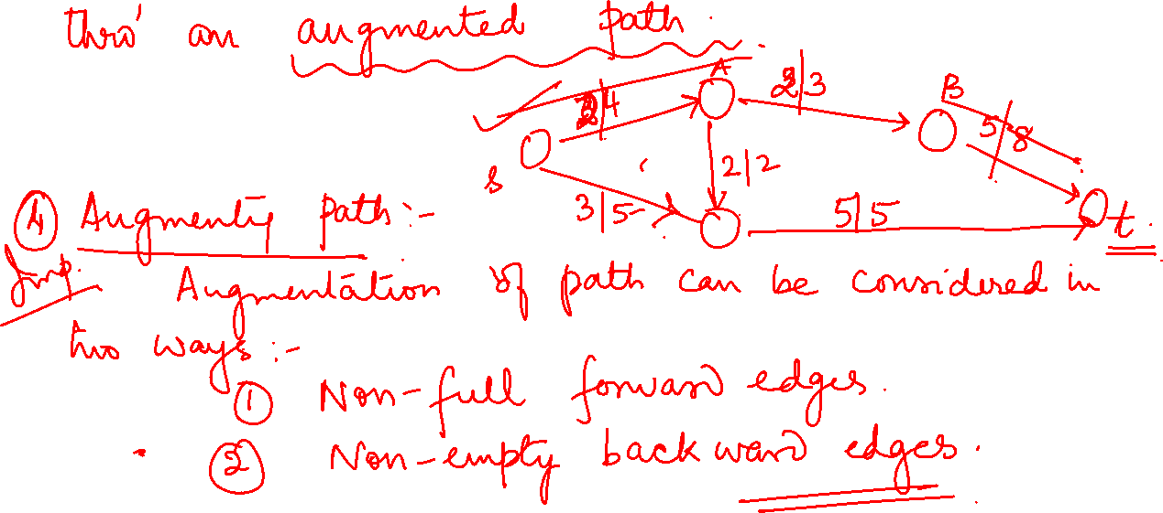

Slide 18
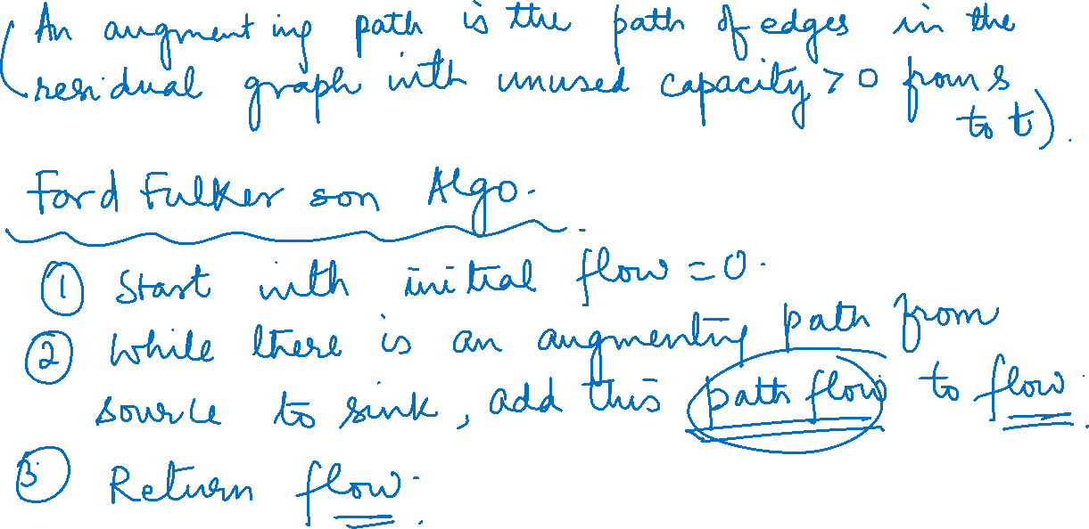

Slide 19
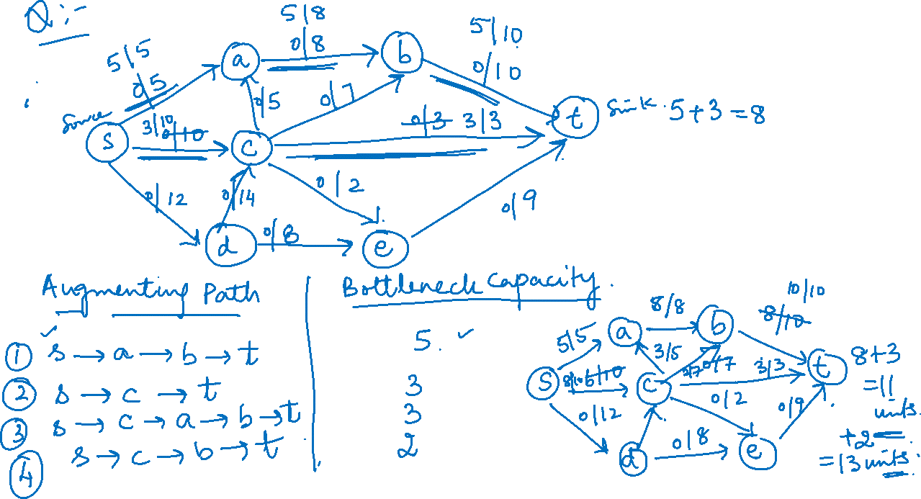

Slide 20
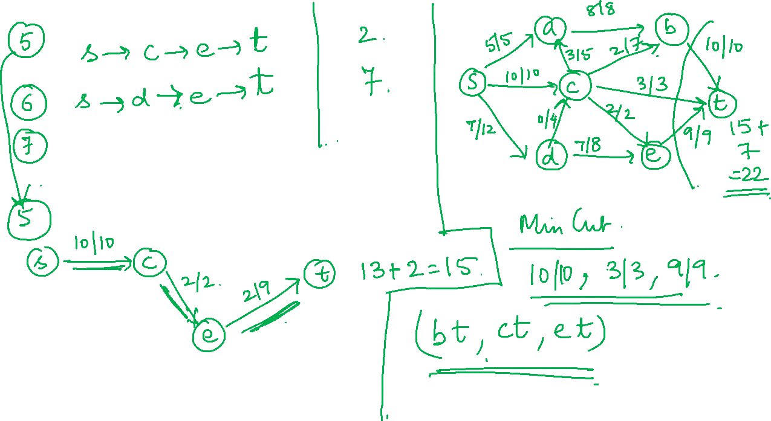

Slide 21
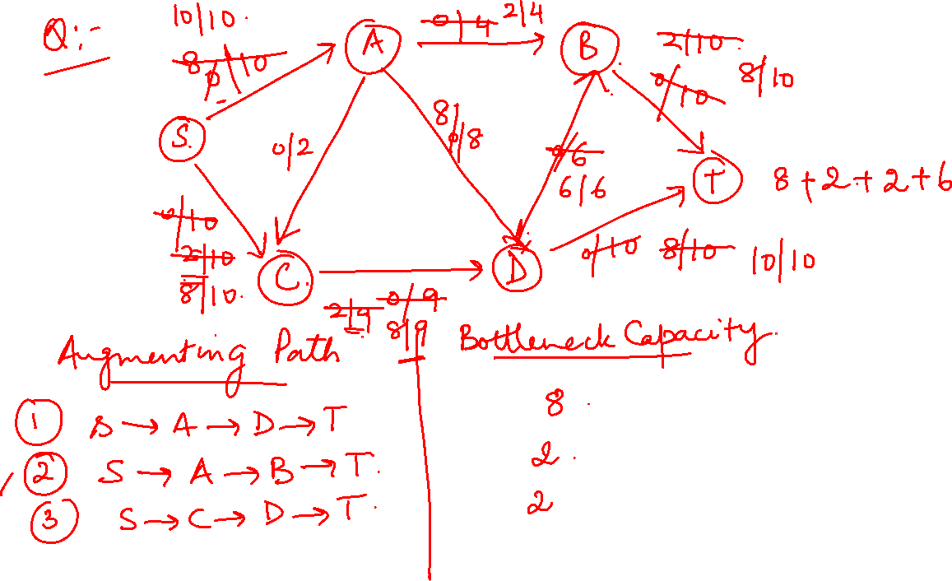

Slide 22
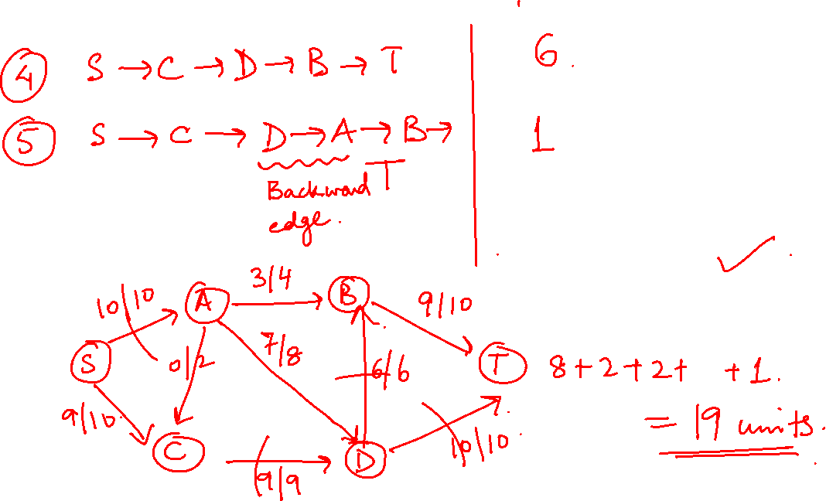

Slide 23
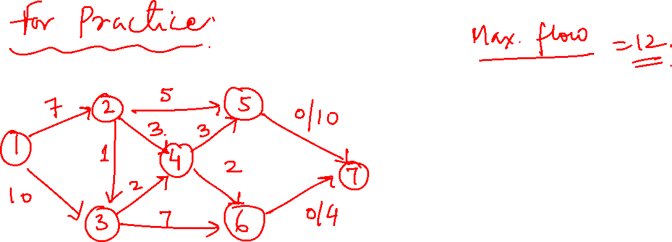

Slide 24
Graph Theory and its Applications MAX FLOW
The Ford-Fulkerson method depends on three important ideas that transcend the method and are relevant to many flow algorithms and problems: residual networks, augmenting paths, and cuts. These ideas are essential to the important max-flow min-cut theorem which characterizes the value of a maximum flow in terms of cuts of the flow network

Slide 25
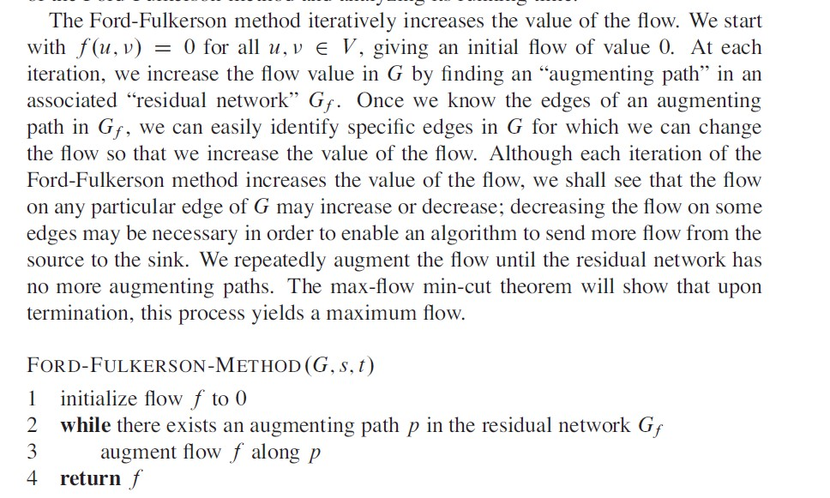
Graph Theory and its Applications MAX FLOW

Slide 26
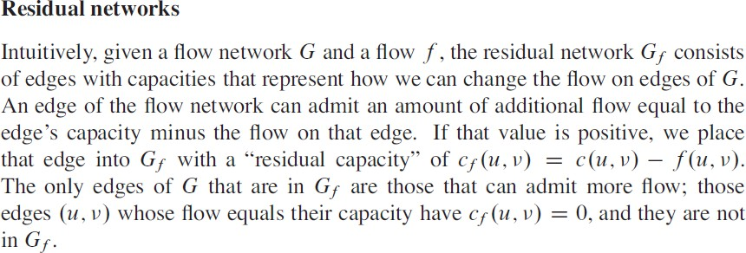
Graph Theory and its Applications MAX FLOW

Slide 27
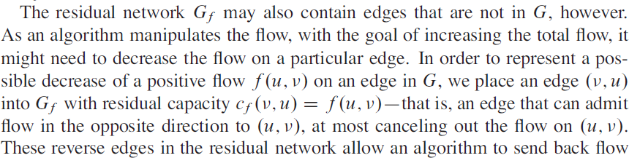
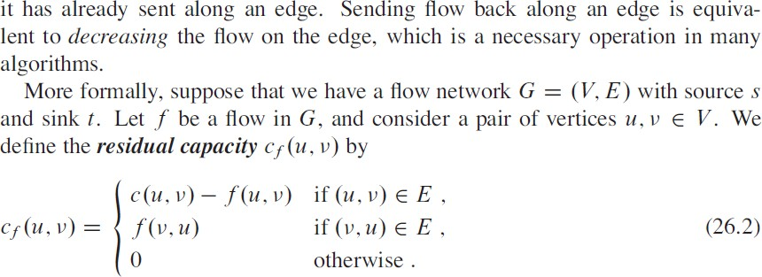
Graph Theory and its Applications MAX FLOW

Slide 28
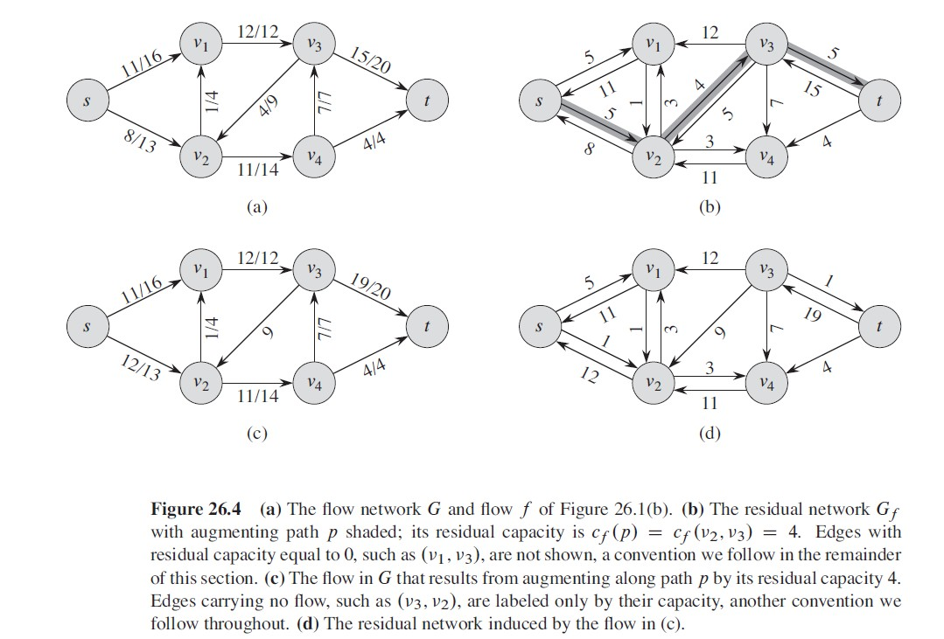
Graph Theory and its Applications MAX FLOW

Slide 29
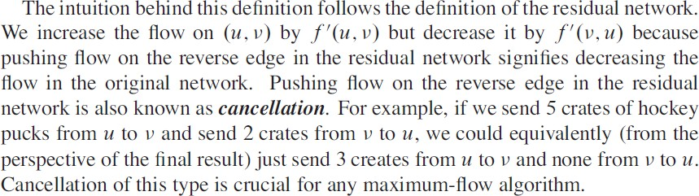
Graph Theory and its Applications MAX FLOW

Slide 30
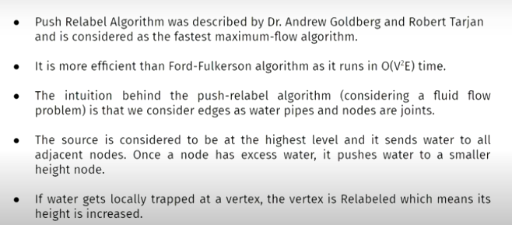

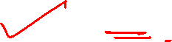
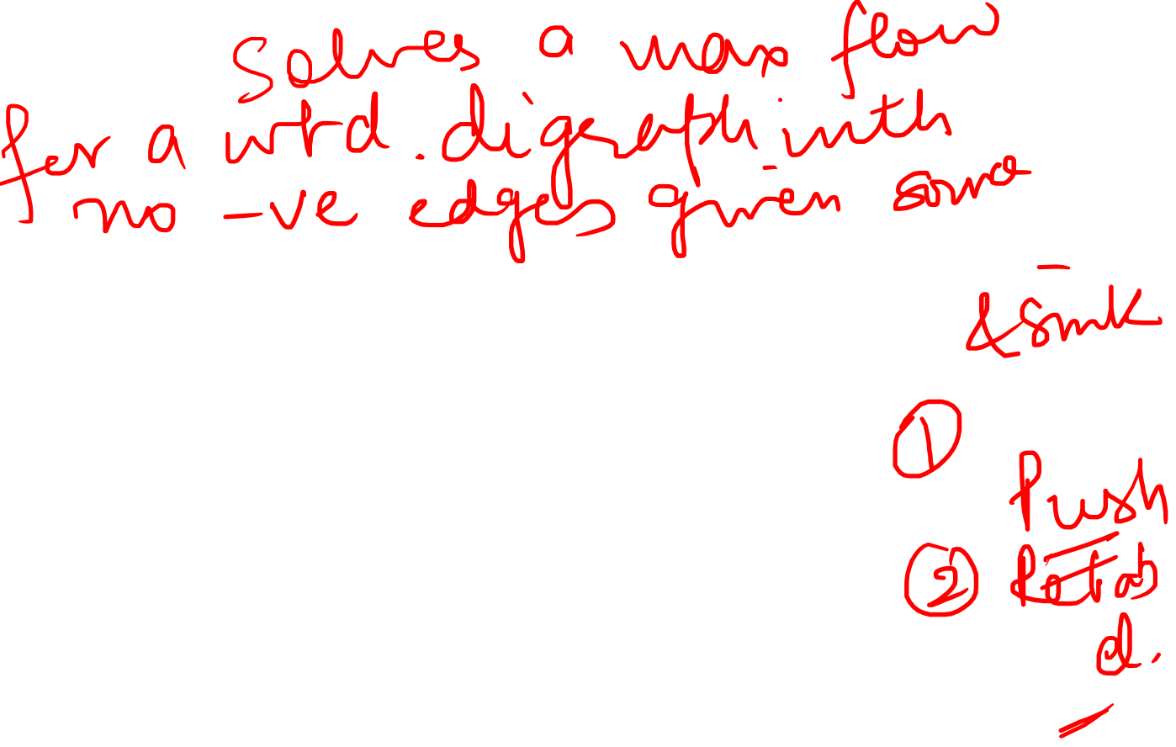
Graph Theory and its Applications Push Relabel Algorithm

Slide 31
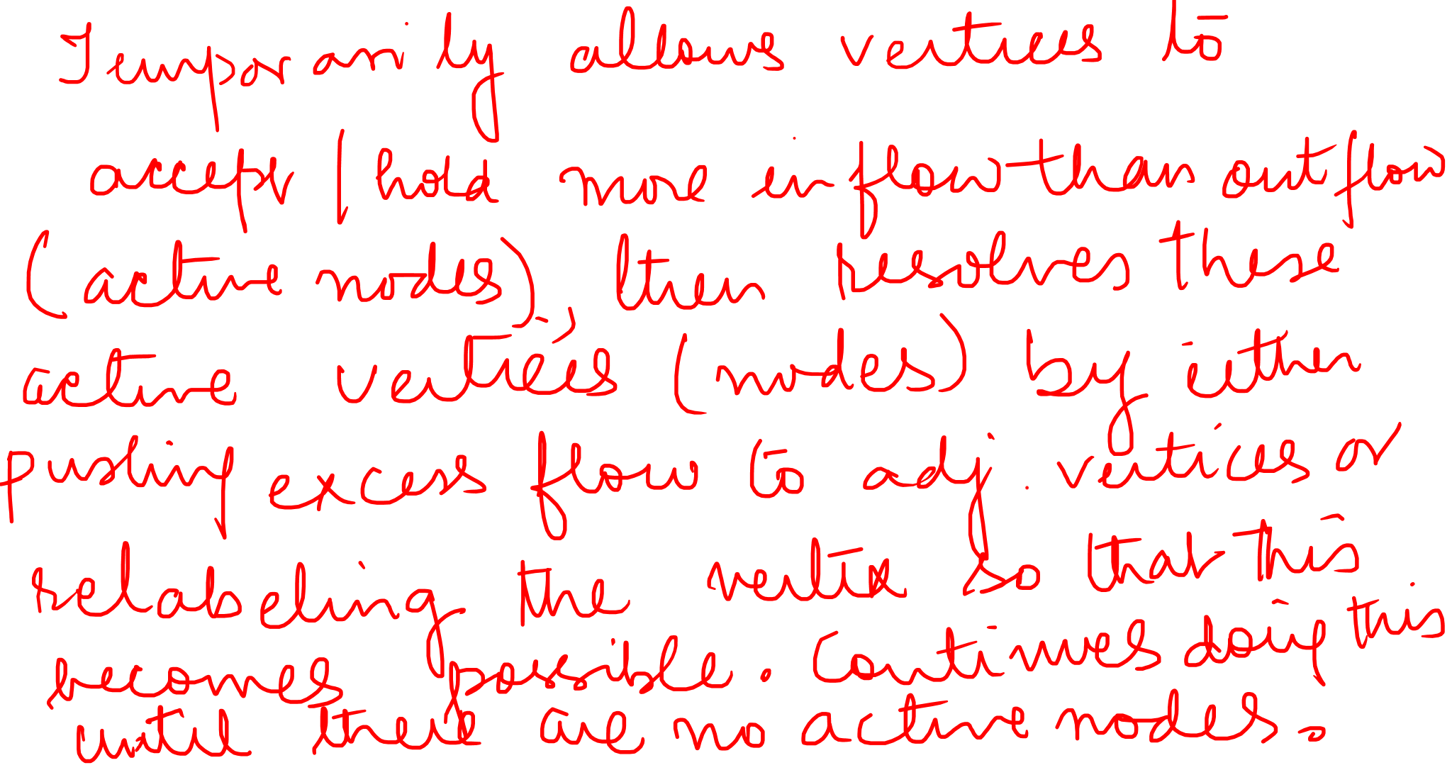

Slide 32
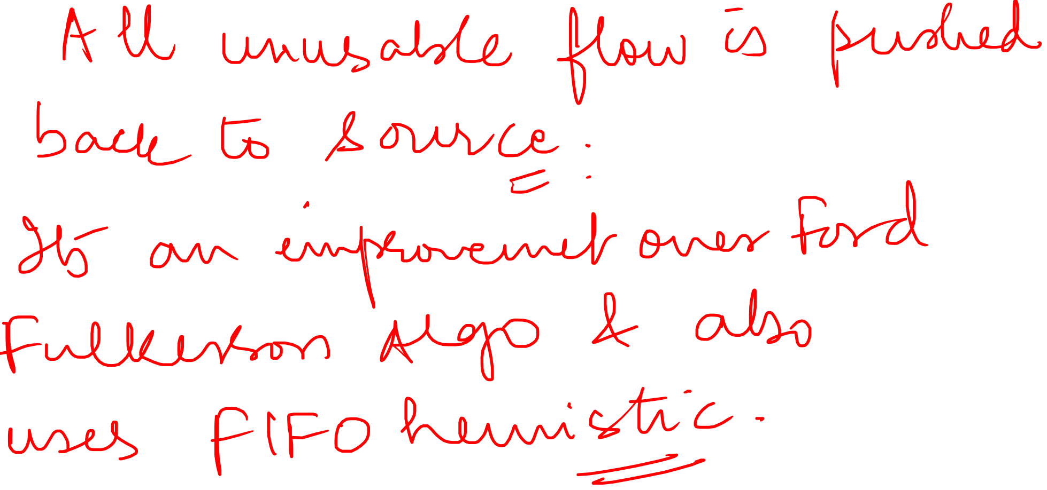

Slide 33
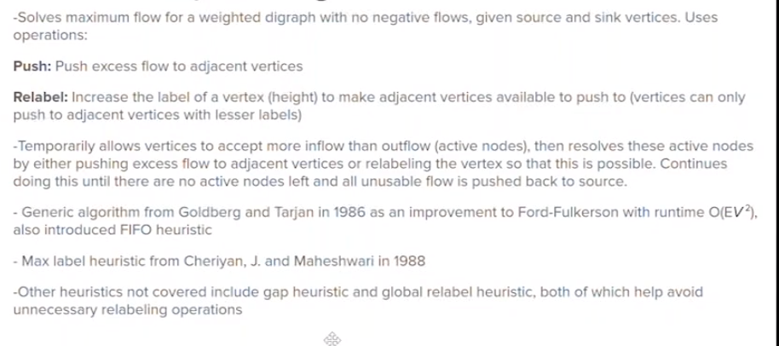
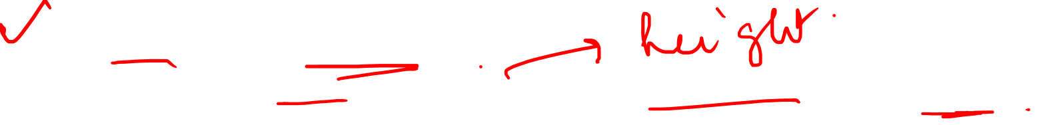

Slide 34
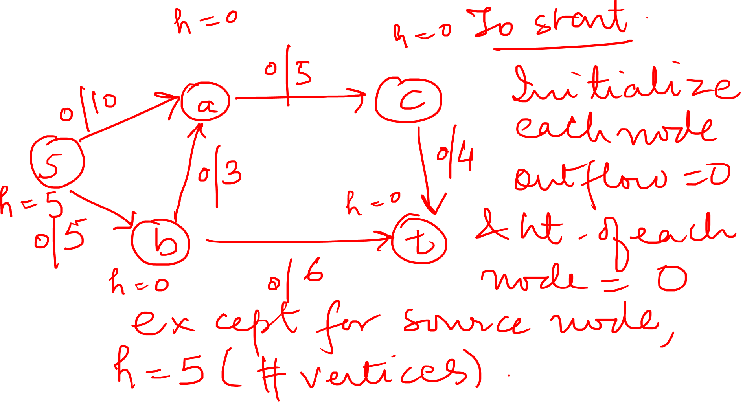

Slide 35
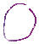
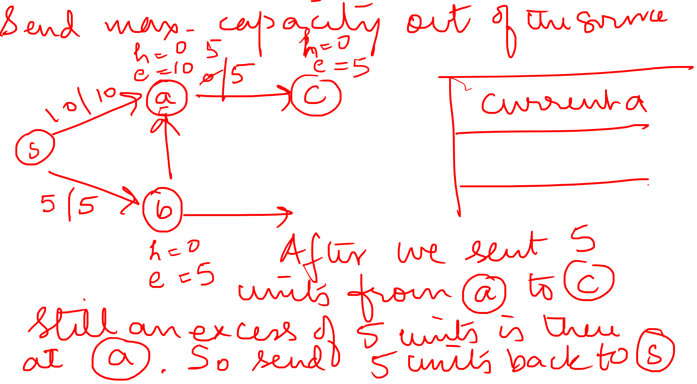

Slide 36
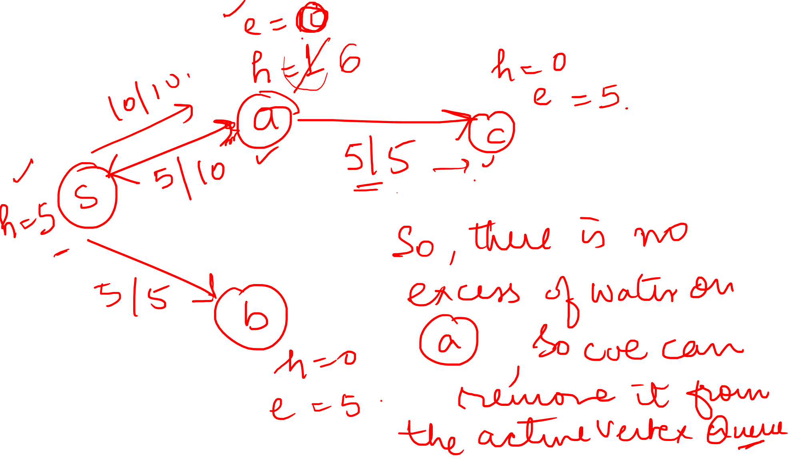

Slide 37
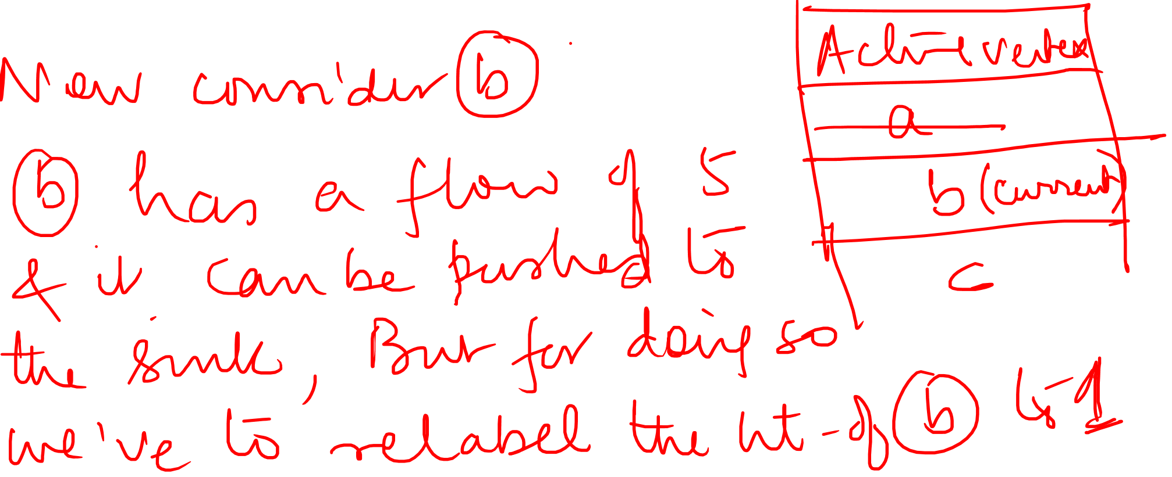

Slide 38
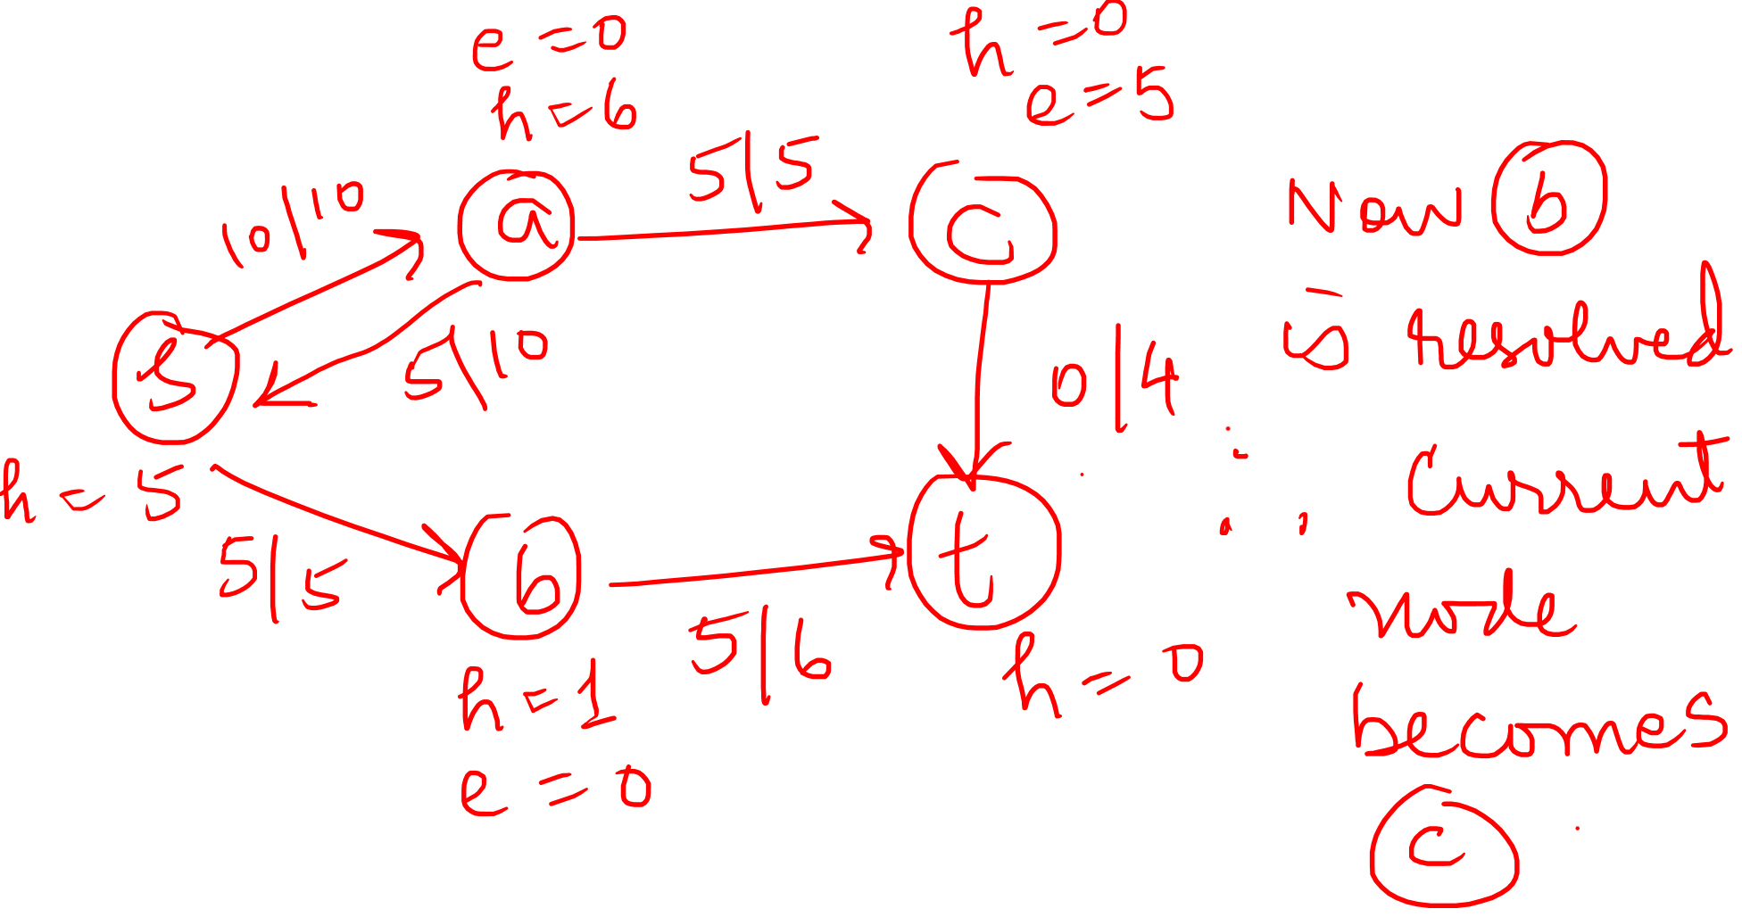

Slide 39
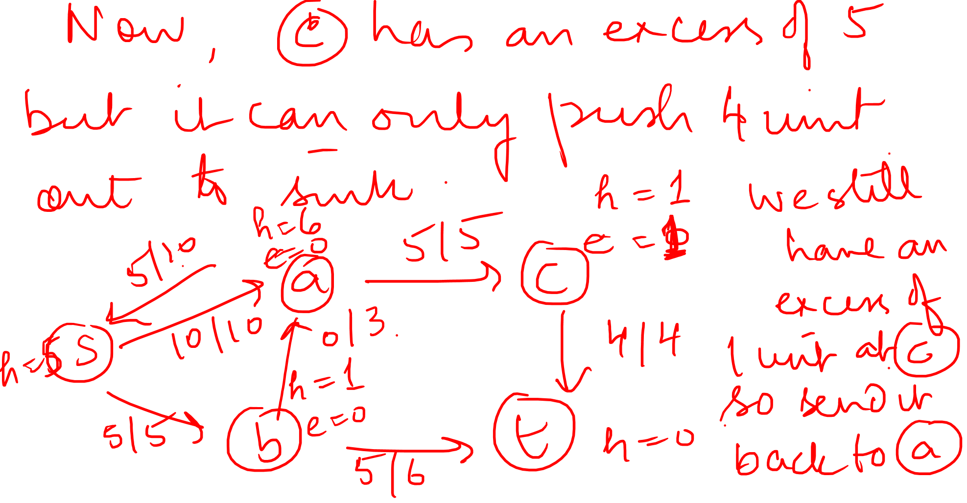

Slide 40
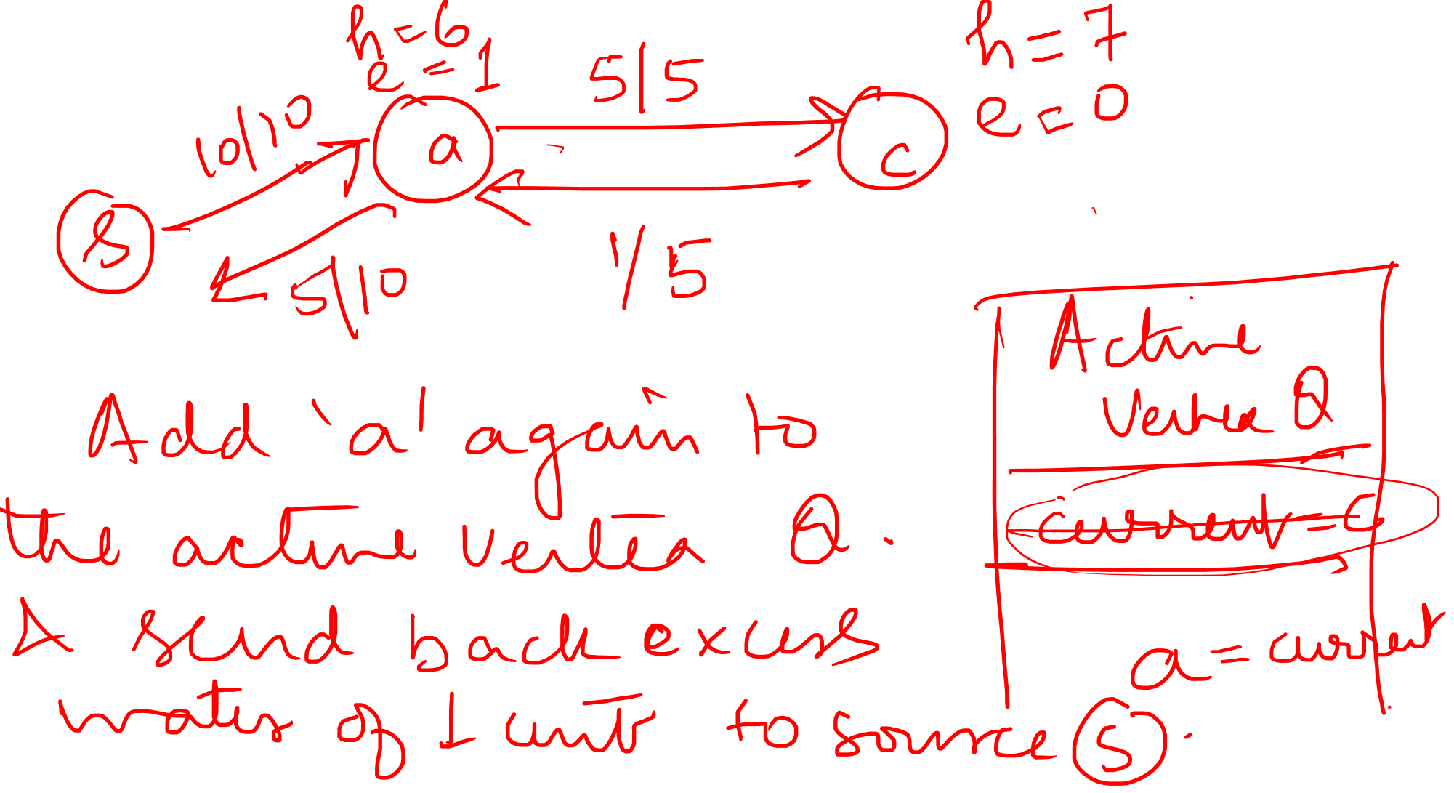

Slide 41
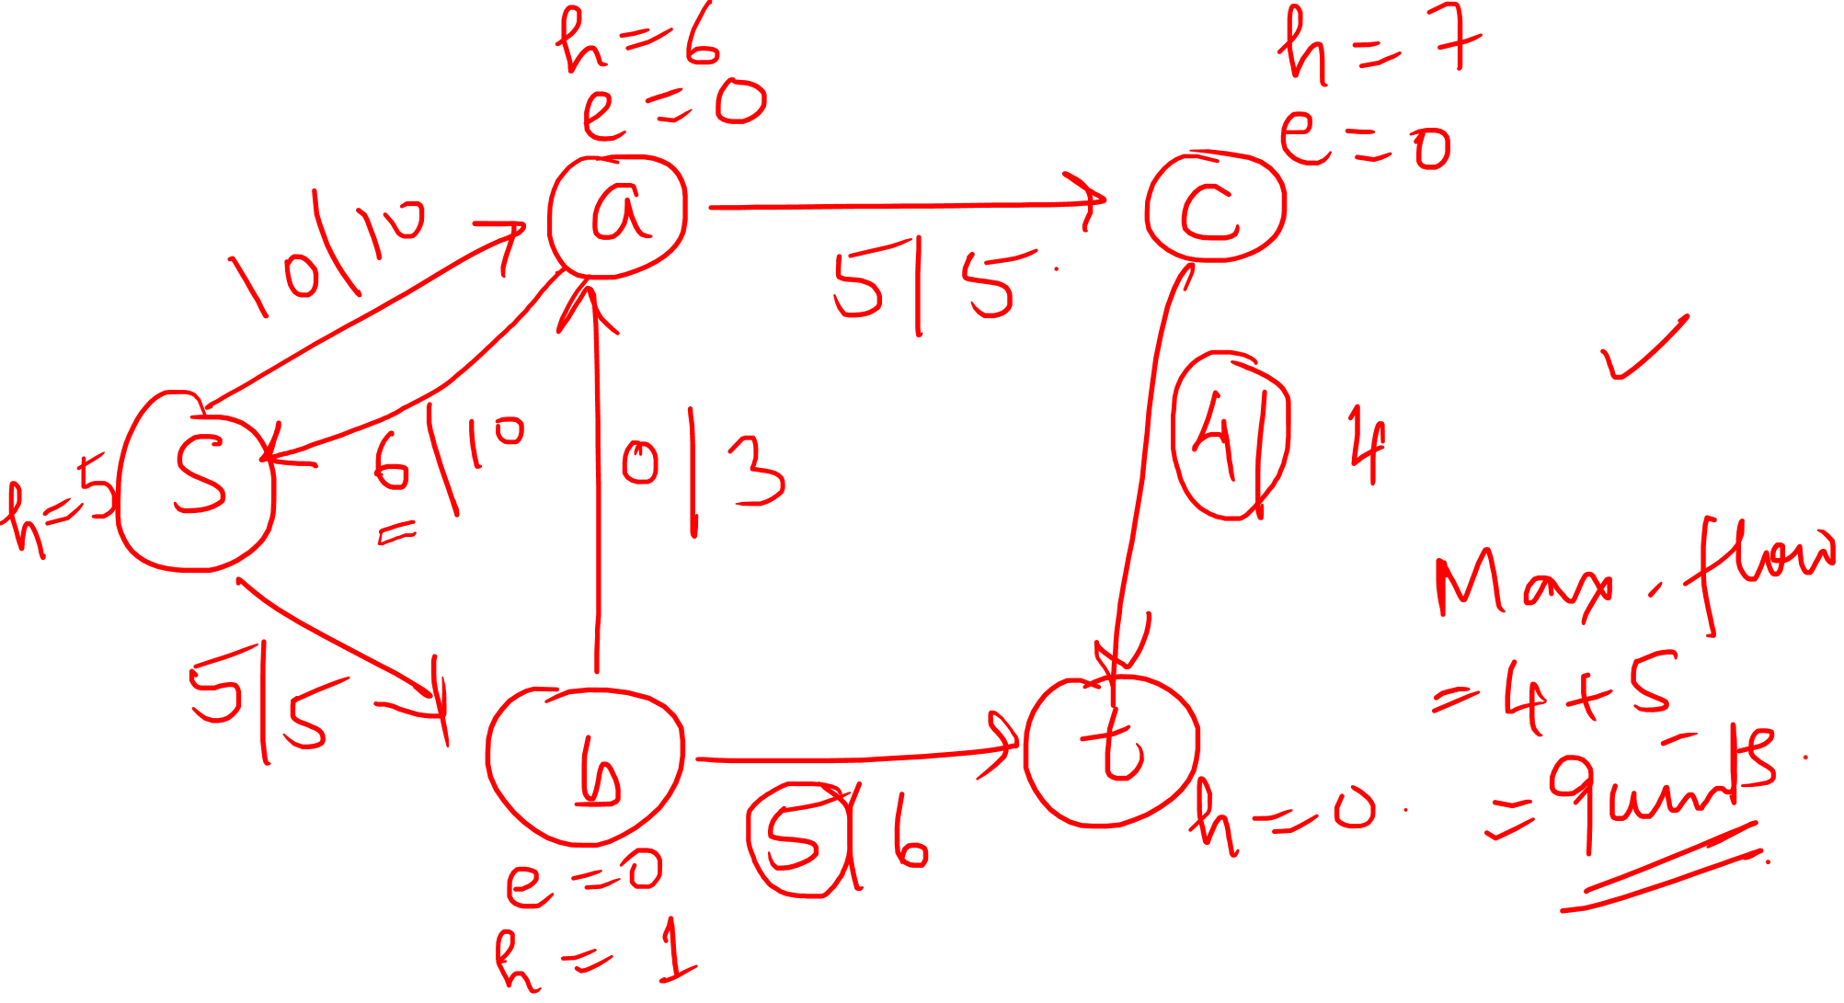

Slide 42
Graph Theory and its Applications MAX FLOW
Push Relabel Algorithm:
Many of the asymptotically fastest maximum-flow algorithms are push-relabel algorithms, and the fastest actual implementations of maximum-flow algorithms are based on the push-relabel method
Push-relabel algorithms work in a more localized manner than the Ford- Fulkerson method. Rather than examine the entire residual network to find an augmenting path, push-relabel algorithms work on one vertex at a time, looking only at the vertex’s neighbors in the residual network

Slide 43
Graph Theory and its Applications MAX FLOW
You can understand the intuition behind the push-relabel method in terms of fluid flows: we consider a flow network G {V;E} to be a system of interconnected pipes of given capacities directed edges correspond to pipes. Vertices, which are pipe junctions, have two interesting properties. First, to accommodate excess flow, each vertex has an outflow pipe leading to an arbitrarily large reservoir that can accumulate fluid. Second, each vertex, its reservoir, and all its pipe connections sit on a platform whose height increases as the algorithm progresses.

Slide 44
Graph Theory and its Applications MAX FLOW
Vertex heights determine how flow is pushed: we push flow only downhill, that is, from a higher vertex to a lower vertex. The flow from a lower vertex to a higher vertex may be positive, but operations that push flow push it only downhill. We fix the height of the source at |V| and the height of the sink at 0. All other vertex heights start at 0 and increase with time. The algorithm first sends as much flow as possible downhill from the source toward the sink. The amount it sends is exactly enough to fill each outgoing pipe from the source to capacity; that is, it sends the capacity of the cut (s, V – {s}) When flow first enters an intermediate vertex, it collects in the vertex’s reservoir. From there, we eventually push it downhill.

Slide 45
Graph Theory and its Applications MAX FLOW
We may eventually find that the only pipes that leave a vertex u and are not already saturated with flow connect to vertices that are on the same level as u or are uphill from u. In this case, to rid an overflowing vertex u of its excess flow, we must increase its height—an operation called “relabeling” vertex u. We increase its height to one unit more than the height of the lowest of its neighbors to which it has an unsaturated pipe. After a vertex is relabeled, therefore, it has at least one outgoing pipe through which we can push more flow.
Eventually, all the flow that can possibly get through to the sink has arrived there. No more can arrive, because the pipes obey the capacity constraints; the amount of flow across any cut is still limited by the capacity of the cut. To make the preflow a “legal” flow, the algorithm then sends the excess collected in the reservoirs of overflowing vertices back to the source by continuing to relabel vertices to above the fixed height |V | of the source

Slide 46
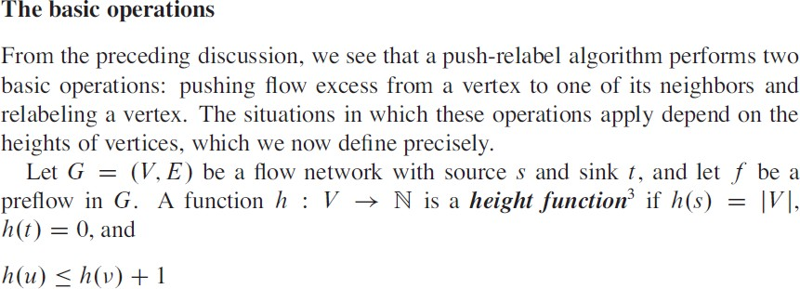
Graph Theory and its Applications MAX FLOW

Slide 47
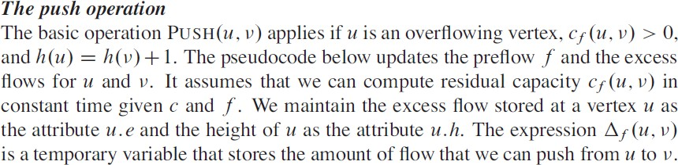
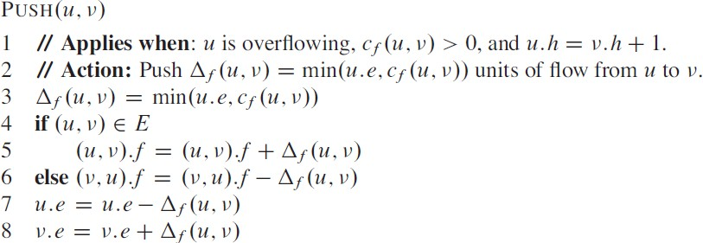
Graph Theory and its Applications MAX FLOW

Slide 48
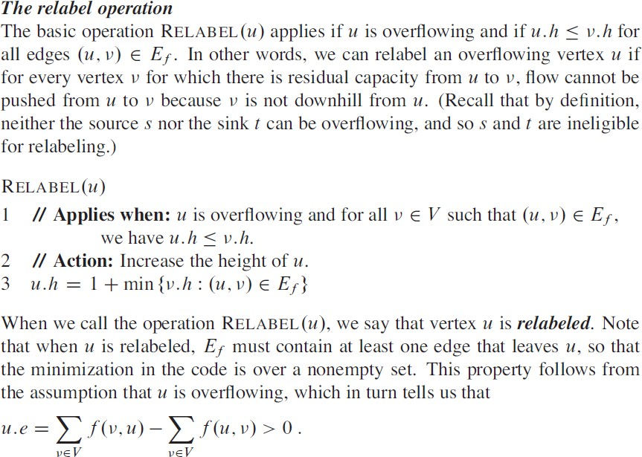
Graph Theory and its Applications MAX FLOW

Slide 49
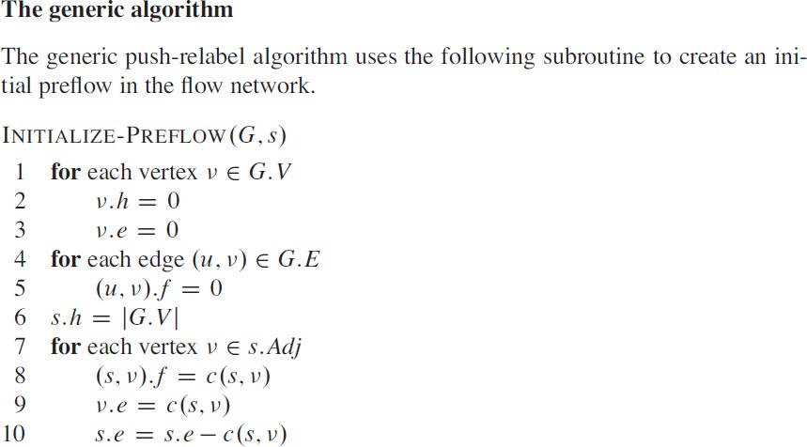
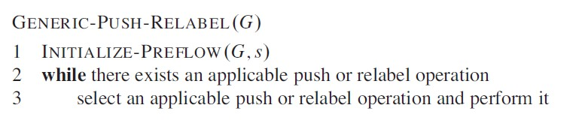
Graph Theory and its Applications MAX FLOW

Slide 50
Graph Theory and its Applications Matching using Ford Fulkerson Algorithm
Matching in Bipartite Graphs
A Matching in a Bipartite Graph is a set of edges chosen in such a way that no two edges chosen in such a way that no two edges share an endpoint. A maximum matching is a matching of maximum size. In a maximum matching if any edge is added to it, it is no longer a matching. There can be more than one maximum matching for a given Bipartite Graph.
Maximum Bipartite Matching can be solved by converting the bipartite graph into a flow network.
Build a Flow Network: There must be a source and sink in a flow network. So we add a source and add edges to all nodes of first partition. Similarly add edges from all nodes in second partition to sink.
Find the maximum flow using Ford Fulkerson algorithm. The max flow is actually the Maximum Matching for the Bipartite Graph.

Slide 51




Graph Theory and its Applications Matching using Ford Fulkerson Algorithm
There are M job applicants and N jobs. Each applicant has a subset of jobs that he/she is interested in. each job opening can only accept one applicant and a job applicant can be appointed for only one job. Find an assignment of jobs to applicants in such a way that as many applicants as possible get jobs.
a1
j1
a2
j2
a3
j3
j4
a4
a5
j5
a6
j6

Slide 52
THANK YOU
Dr. Arti Arya
Department of Computer Science & Engineering
artiarya@pes.edu

